Slide 1
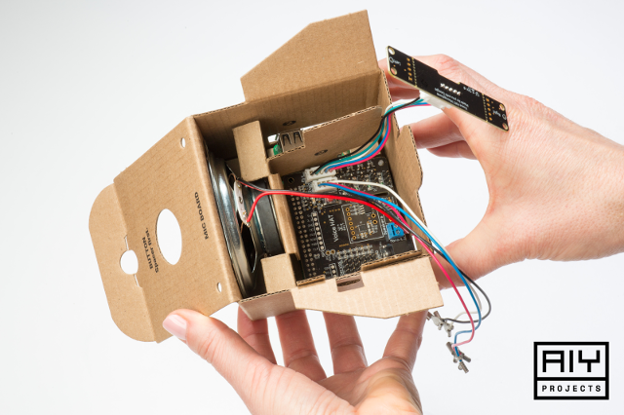
The Raspberry Pi Voice Kit
Alex Shevchuk
AP Computer Science, Ms.Wear

Slide 2
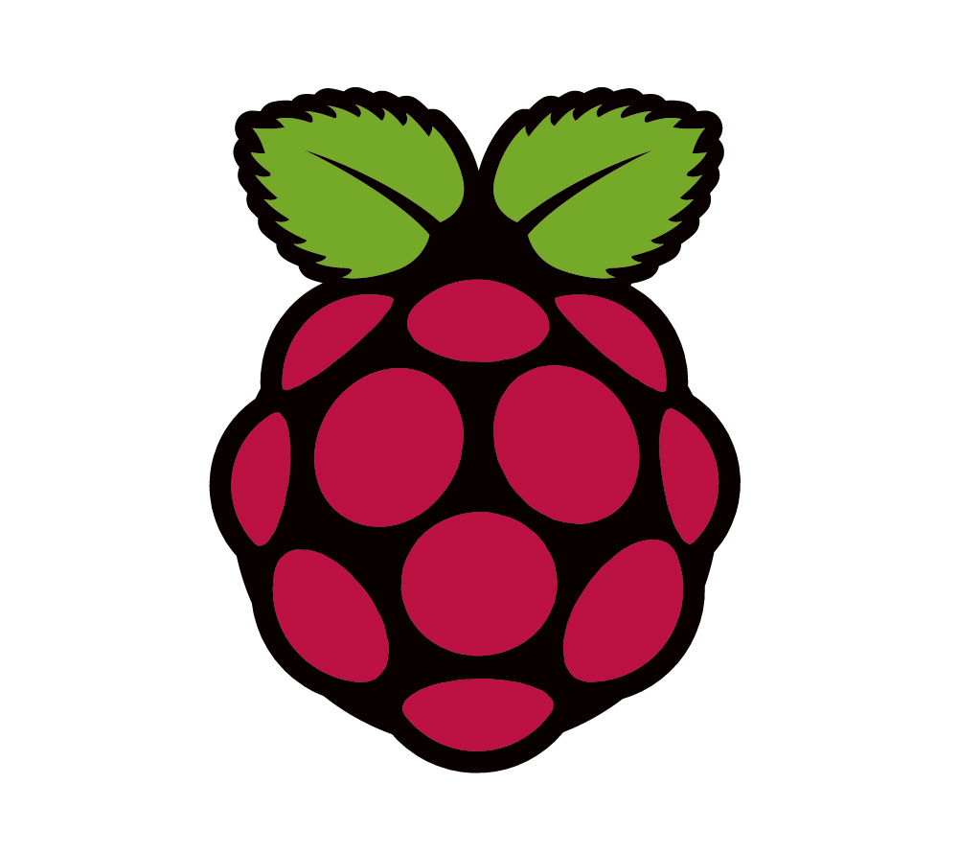
Topics Covered
Raspberry Pi basics
Prerequisites
The Google Voice Kit (Assistant) API
The Google Classroom API
Live demo
Difficulties encountered
Course adaptability

Slide 3
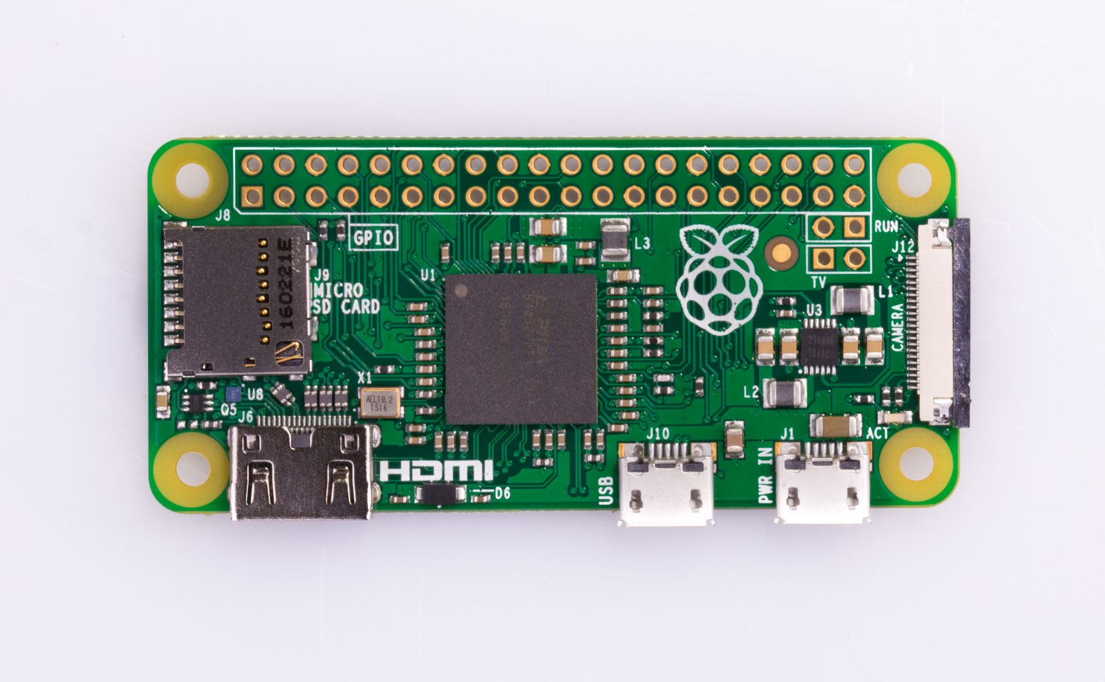
The Raspberry Pi
512MB RAM, 1Ghz single core (fairly slow)
Model name: zero
Used around the world by hobbyists, children, professionals, and even Bitcoin miners
Cheap, affordable computer
Incredibly versatile, can be used for almost anything thanks to GPIO pins
Linux-based operating system “Raspian”
Pi is for Pithon
Python is a simple and awesome high-level language
Easy to transition into
Interpretive rather than compiled

Slide 4
Getting Started
Python modules are the equivalent of Java libraries
Installing modules through PIP Package Manager is incredibly easy
Pip install *module_name*
The Pi was connected over SSH through a Chrome extension, allowing use of the Pi via terminal commands
One can use Python in the Linux (Pi) command line by typing python *command*
WinSCP can be used to transfer files

Slide 5
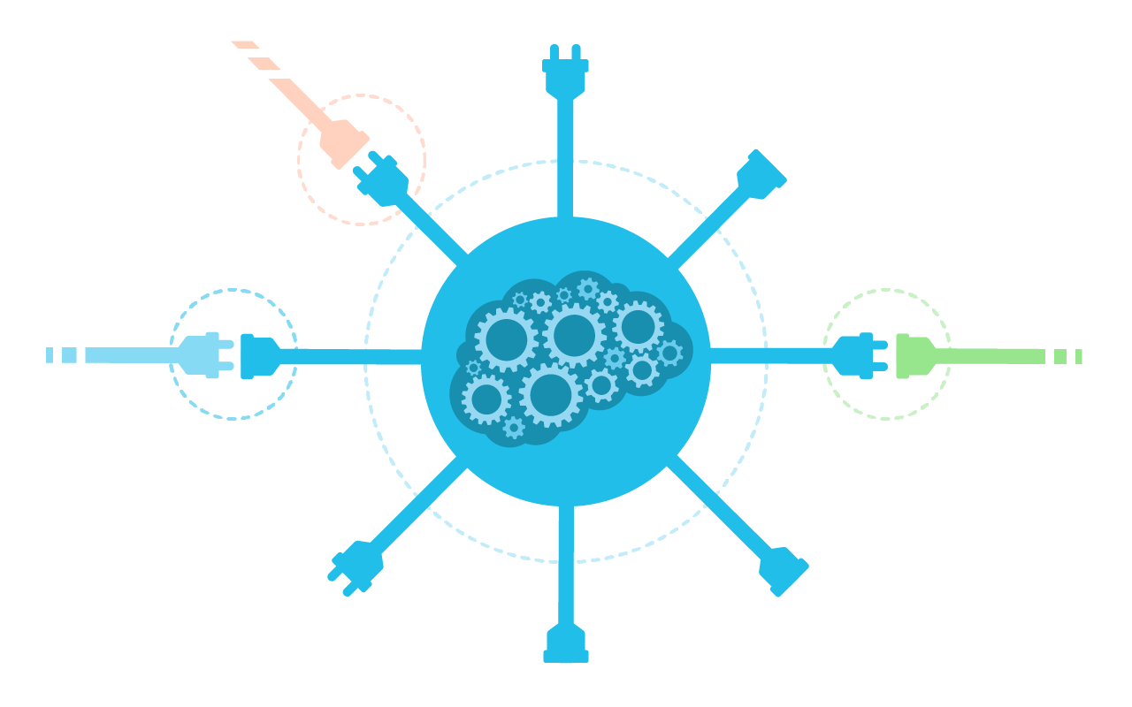
API Basics
Application Programming interfaces (APIs) are used to interact with the outside world
In Python, and API comes in the form of modules
In Java, APIs come in the form of libraries
APIs can contain objects, methods, variables etc
Basically a packaged block of code for others to use
Why write your own code when others have written it (DRY principle)
Solves the problem of dealing with voice IO
Found everywhere

Slide 6
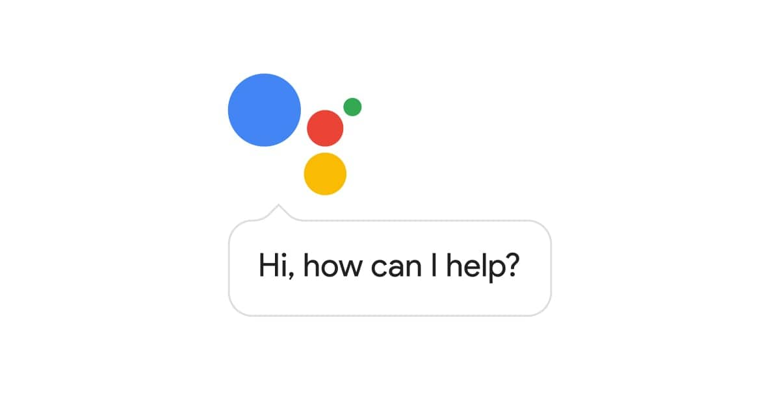
The Voice Kit API
Google has awesome tutorials which showcase their Voice Kit API
IO is handled by creating several objects and calling methods on them
Assistant object recognizes text
Aiy object handles text output
More objects and functionalities can be found on API website
Commands are fairly basic and easy to use
Example: aiy.audio.say(*string*) will make the Pi talk
Assistant.recognize() listens and returns a message in the form of text
Authorization is required to use the API and is handled through one’s Google account
Fairly simple

Slide 7
The Google Classroom API
Google API, therefore is very similar to Voice Kit API
Google’s tutorials are even more comprehensive, containing thorough instructions and plentiful sample code
Courses and assignments are passed as lists of data, can be accessed as one would access an array element
Example: course[“title”] would return the title of the course
Courses and assignments have properties such as:
Title, description, dates published, current status, publisher/teacher

Slide 8
Live Demo
Raspberry Pi interacts with Google Classroom API using the Voice Kit API
API madness
Functionality includes:
Creating courses
Listing courses
Creating assignments
Listing assignments
Viewing specific assignment criteria

Slide 9

Things to watch out for
Laptops cannot be used unless one has an ethernet adapter
Python 2 vs Python 3 incompatibility
Results in “ImportError”s (which take nonstop days to fix) and other difficulties importing the modules through PIP
Try typing pip3 instead of pip and python3 instead of python
Raspberry Pi issues
Reboot Pi first
If unsuccessful, reset the software
Faulty voice recognition
Try headphones

Slide 10
“Can I use this in my course?”
Prerequisites:
General understanding of programming (acquired in IT 12)
AP-level understanding of Java is not needed and will not benefit since Python is used
Ability to “figure stuff out” without the help of a teacher is the most important requirement
Project is most applicable to students who have finished the IT 12 curriculum, as the PHP unit is almost entirely self taught from php.net
Very cool and interesting project
Familiarizing oneself with new APIs without guidance is very beneficial to students
>> Android development
Should definitely be used in future courses

Slide 11
Conclusion
Project involves lots of new technology which needs to be learnt, although the time given is sufficient to do so
Most of the time is spent learning the new technology rather than working on final project
Technology is really cool so learning it is very interesting
Definitely the best part of APCS course
Good fit for APCS since the rest of the course does not have any projects
Fun time, would recommend

Slide 12

Hope you learned something!

